Slide 1
Chapter 3 Processes

Slide 2
Chapter 3 Processes
Process Concept
Process Scheduling
Operations on Processes
Interprocess Communication
IPC in Shared-Memory Systems
IPC in Message-Passing Systems
Examples of IPC Systems
Communication in Client-Server Systems

Slide 3
3.1 Process Concept

Slide 4
Objectives
Identify the separate components of a process and illustrate how they are represented and scheduled in an operating system.
Describe how processes are created and terminated in an operating system, including developing programs using the appropriate system calls that perform these operations.
Describe and contrast interprocess communication using shared memory and message passing.
Design programs that uses pipes and POSIX shared memory to perform interprocess communication.
Describe client-server communication using sockets and remote procedure calls.
Design kernel modules that interact with the Linux operating system.

Slide 5

3.1 Process Concept
A process is a program in execution (an active entity, i.e. it is a running program )
Basic unit of work on a computer, a job, a task.
A container of instructions with some resources:– e.g. CPU time (CPU carries out the instructions), memory, files, I/O devices to accomplish its task
Examples: compilation process, word processing process, scheduler (sched, swapper) process or daemon processes: ftpd, httpd
jobs作业=user programs用户程序= tasks任务= process 进程
IBM
Multics

Slide 6
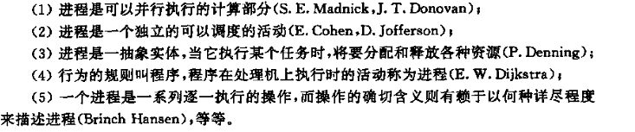
Process Concept
进程是什么？
一个具有一定独立功能的程序在一个数据集合上的一次动态执行过程。
正在执行中的程序 a program in execution
张尧学，计算机操作系统教程，清华大学出版社

Slide 7
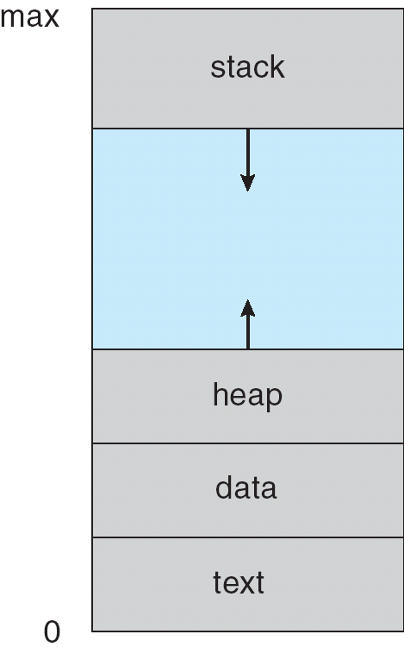
Process in Memory
A process includes:
The program code, also called text section
Program counter (PC)
Registers
Data section (global data)
Stack (temporary data)
Heap (dynamically allocated memory)
code

Slide 8
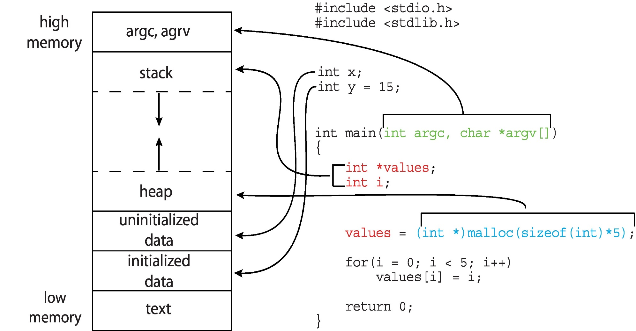
Memory Layout of a C Program

Slide 9
Process State 进程状态
As a process executes, it changes state
New（新）: The process is being created.
Running（运行、执行）: Instructions are being executed.
Ready（就绪）: The process is waiting to be assigned to a processor (CPU).
Waiting（等待、blocked阻塞）: The process is waiting for some event to occur.
Terminated（终止）: The process has finished execution.

Slide 10
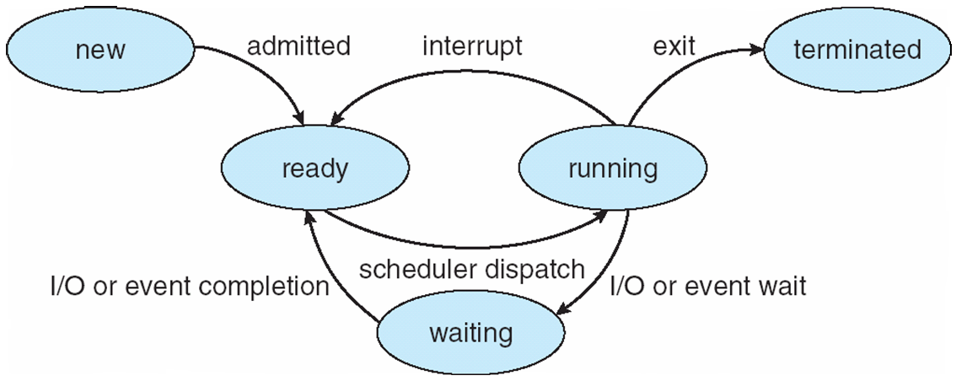
State Transitions
A process may change state as a result:
Program action (system call)
OS action (scheduling decision)
External action (interrupts)

Slide 11
进程状态的转换
三个基本状态之间可能转换和转换原因如下：
就绪→运行：当处理器空闲时，进程调度程序必将处理机分配给一个处于就绪状态的进程 ，该进程便由就绪状态转换为运行状态。
运行→等待：处于运行状态的进程在运行过程中需要等待某一事件发生后（例如因I／O请求等待I／O完成后），才能继续运行，则该进程放弃处理器，从运行状态转换为等待状态。
等待→就绪：处于等待状态的进程，若其等待的事件已经发生，于是进程由等待状态转换为就绪状态。
运行→就绪：处于运行状态的进程在其运行过程中，因分给它的处理器时间片已用完，而不得不让出（被抢占）处理器，于是进程由运行态转换为就绪态。
等待→运行，就绪→等待这二种状态转换一般不可能发生。

Slide 12
进程状态与处理器
处于运行状态进程:如系统有一个处理器，则在任何一时刻，最多只有一个进程处于运行状态。
处于就绪状态进程:一般处于就绪状态的进程按照一定的算法（如先来的进程排在前面，或采用优先权高的进程排在前面）排成一个就绪队列。
处于等待状态进程:处于等待状态的进程排在等待队列中。由于等待事件原因不同，等待队列也可以按事件分成几个队列。

Slide 13
Process State
Windows NT/2000 线程有7种状态；Linux进程有6种状态；Windows 2003 server线程有9种状态.
include/linux/sched.h
124 #define TASK_RUNNING 0
125 #define TASK_INTERRUPTIBLE 1
126 #define TASK_UNINTERRUPTIBLE 2
127 #define TASK_STOPPED 4
128 #define TASK_TRACED 8
129 /* in tsk->exit_state */
130 #define EXIT_ZOMBIE 16
131 #define EXIT_DEAD 32
132 /* in tsk->state again */
133 #define TASK_NONINTERACTIVE 64

Slide 14
include/linux/sched.h（4.2）
#define TASK_RUNNING 0
#define TASK_INTERRUPTIBLE 1
#define TASK_UNINTERRUPTIBLE 2
#define __TASK_STOPPED 4
#define __TASK_TRACED 8
/* in tsk->exit_state */
#define EXIT_DEAD 16
#define EXIT_ZOMBIE 32
#define EXIT_TRACE (EXIT_ZOMBIE | EXIT_DEAD)
/* in tsk->state again */
#define TASK_DEAD 64
#define TASK_WAKEKILL 128
#define TASK_WAKING 256
#define TASK_PARKED 512
#define TASK_NOLOAD 1024
#define TASK_STATE_MAX 2048
#define TASK_STATE_TO_CHAR_STR "RSDTtXZxKWPN"
extern char ___assert_task_state[1 - 2*!!(
sizeof(TASK_STATE_TO_CHAR_STR)-1 != ilog2(TASK_STATE_MAX)+1)];
/* Convenience macros for the sake of set_task_state */
#define TASK_KILLABLE (TASK_WAKEKILL | TASK_UNINTERRUPTIBLE)
#define TASK_STOPPED (TASK_WAKEKILL | __TASK_STOPPED)
#define TASK_TRACED (TASK_WAKEKILL | __TASK_TRACED)
……
Notes:
TASK_WAKEKILL 用于在接收到kill信号时唤醒进程。
Linux kernel 2.6.25 引入了一种新的进程状态，名为 TASK_WAKEKILL，用于将进程置为睡眠状态，它可以替代有效但可能无法终止的 TASK_UNINTERRUPTIBLE 进程状态，以及易于唤醒但更加安全的 TASK_INTERRUPTIBLE 进程状态。2002 年，OpenAFS 文件系统驱动程序在阻塞所有信号之后等待事件中断时遇到了问题，而 TASK_WAKEKILL 就是因此而被推出的。这种新的睡眠状态允许 TASK_UNINTERRUPTIBLE 响应致命信号。

Slide 15
进程与程序
进程与程序的区别
进程是动态的，程序是静态的：程序是有序代码的集合；进程是程序的执行。
进程是暂时的，程序是永久的：进程是一个状态变化的过程，程序可长久保存。
进程与程序的组成不同：进程的组成包括程序、数据和进程控制块（即进程状态信息）。
进程与程序的对应关系：通过多次执行，一个程序可对应多个进程；通过调用关系，一个进程可包括多个程序

Slide 16
实例
例：一个只有一个处理器的系统中，OS的进程有运行、就绪、等待三个基本状态。假如某时刻该系统中有10个进程并发执行，在略去调度程序所占用时间情况下（在user mode下），请问：
这时刻系统中处于运行状态的进程数最多有几个？最少有几个？
这时刻系统中处于就绪状态的进程数最多有几个？最少有几个？
这时刻系统中处于等待状态的进程数最多有几个？最少有几个？

Slide 17
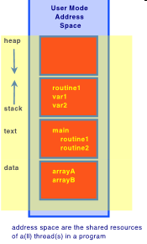
What Makes up a Process?
User resources/OS Resources:
Program code (text)
Data
global variables
heap (dynamically allocated memory)
Process stack
» function parameters
» return addresses
» local variables and functions
OS Resources, environment
open files, sockets
Credential for security
Registers
program counter, stack pointer

Slide 18
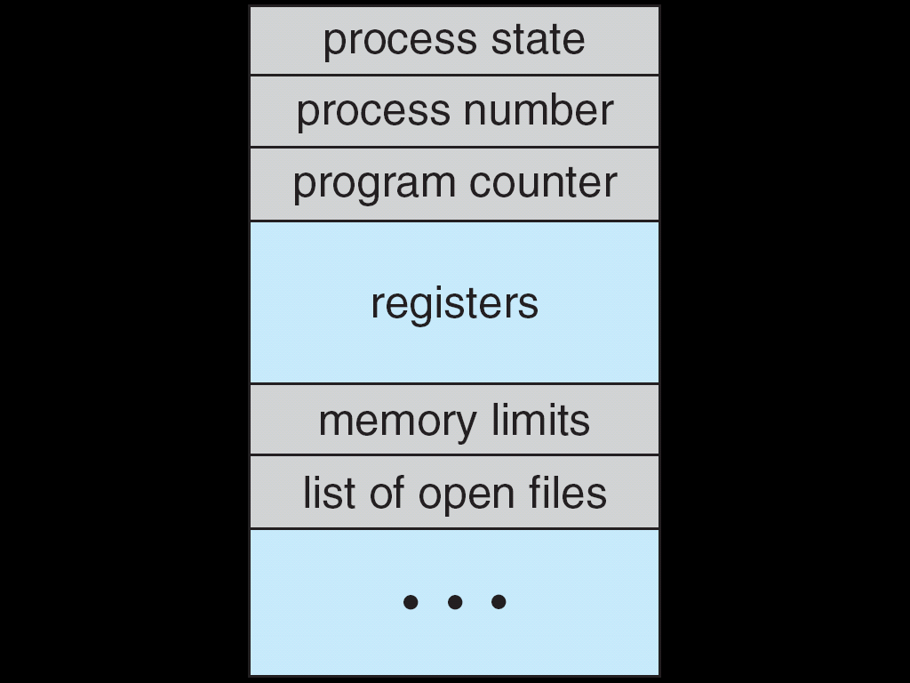
Process Control Block (PCB，进程控制块)
What is needed to keep track of a Process?
每个进程在操作系统内用进程控制块来表示，它包含与特定进程相关的许多信息：
Process state
Program counter
CPU registers
CPU scheduling information
Memory-management information
Accounting information
File management
I/O status information

Slide 19
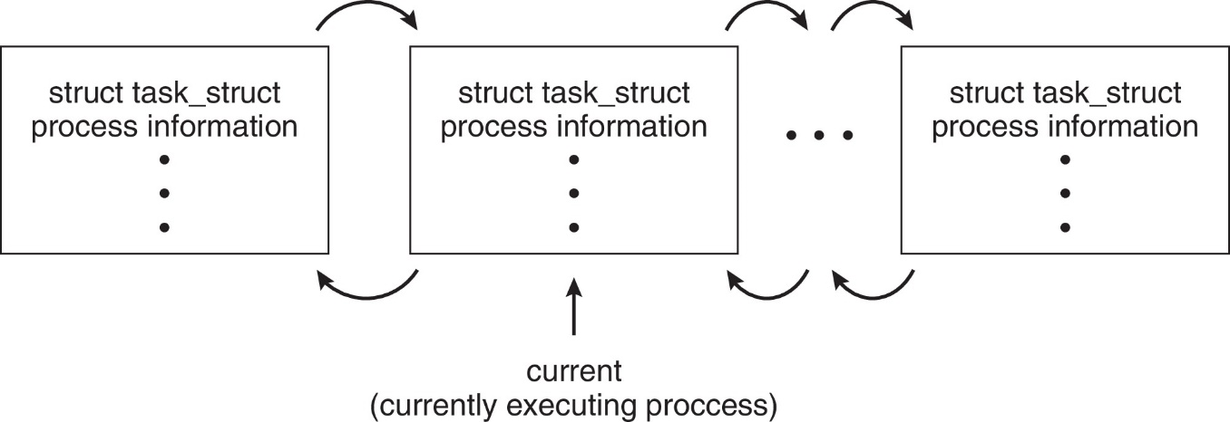
LINUX PCB
In Linux a process’ information is kept in a structure called struct task_struct declared in
#include/linux/sched.h
struct task_struct {
pid_t pid; /* process identifier */
long state; /* state for the process */
unsigned int time_slice /* scheduling information */
struct mm_struct *mm /* address space of this process */
……
}

Slide 20
Open Solaris proc

Slide 21
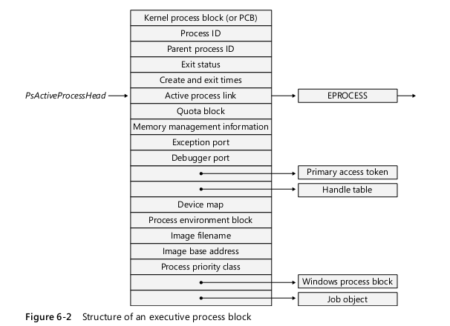
Windows executive process block

Slide 22
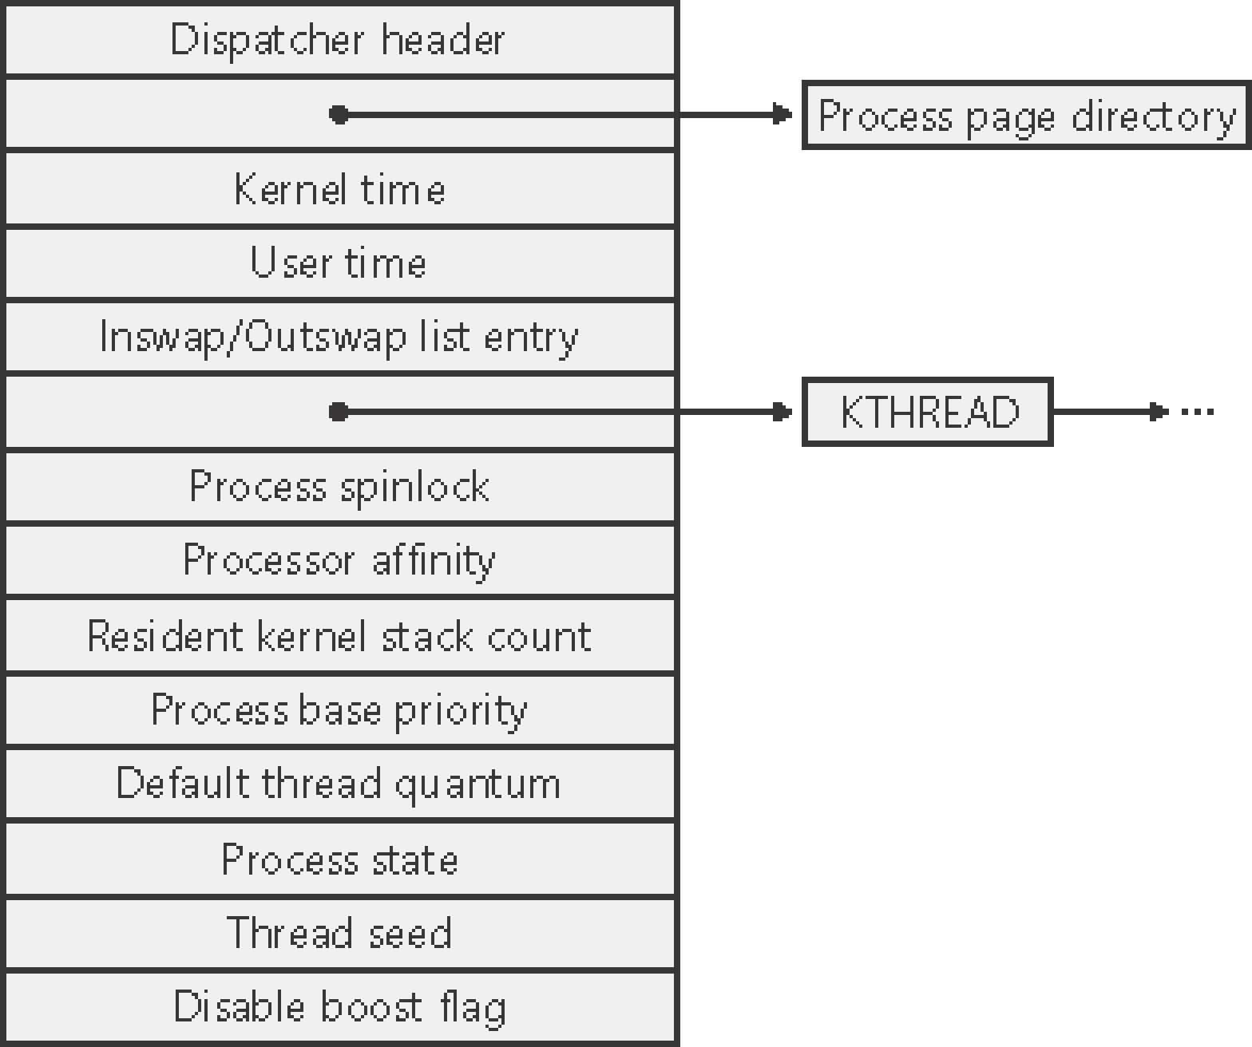
Windows kernel process (KPROCESS) block

Slide 23
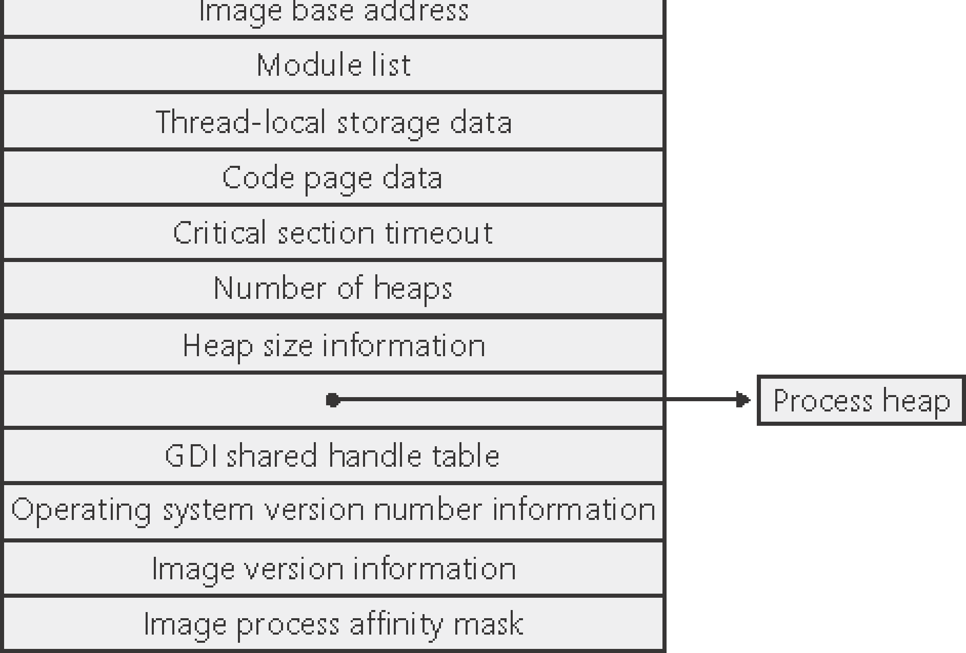
Windows process environment block（PEB）

Slide 24
3.2 Process Scheduling

Slide 25
Process Scheduling 进程调度
3.2.1 Scheduling Queues
Job queue – set of all processes in the system.
Ready queue – set of all processes residing in main memory, ready and waiting to execute.
Device queues – set of processes waiting for an I/O device.
Process migration between the various queues.

Slide 26
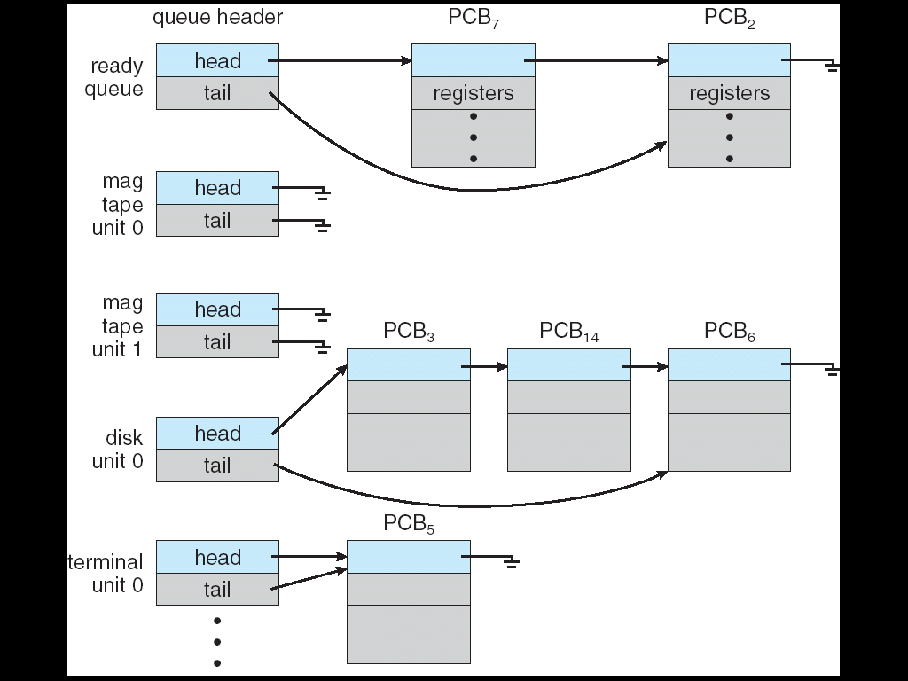
Fig 3.4 Ready Queue And Various I/O Device Queues

Slide 27
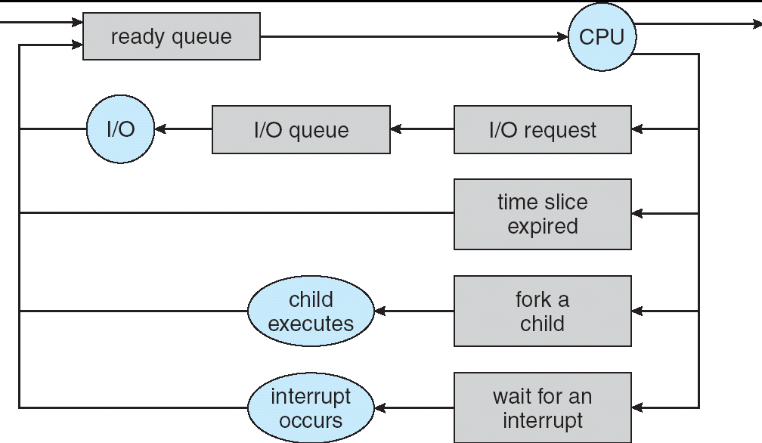
Fig 3.5 Representation of Process Scheduling

Slide 28
3.2.2 Schedulers
Long-term scheduler (or job scheduler)长程调度（或作业调度）
selects which processes should be brought into the ready queue.
invoked very infrequently (seconds, minutes) ⇒ (may be slow)
controls the degree of multiprogramming多道程序的“道”
Most modern operating systems have no long-term scheduler (e.g. Windows, UNIX,Linux)
Short-term scheduler (or CPU scheduler)短程调度（或CPU调度）
selects which process should be executed next and allocates CPU.
invoked very frequently (milliseconds) ⇒ (must be fast).
Medium-Term Scheduler 中程调度
将一些进程从内存中临时移出，从而减少调度器须要处理进程的数目。这样将进程移出内存的机制叫做换出(Swapping)

Slide 29
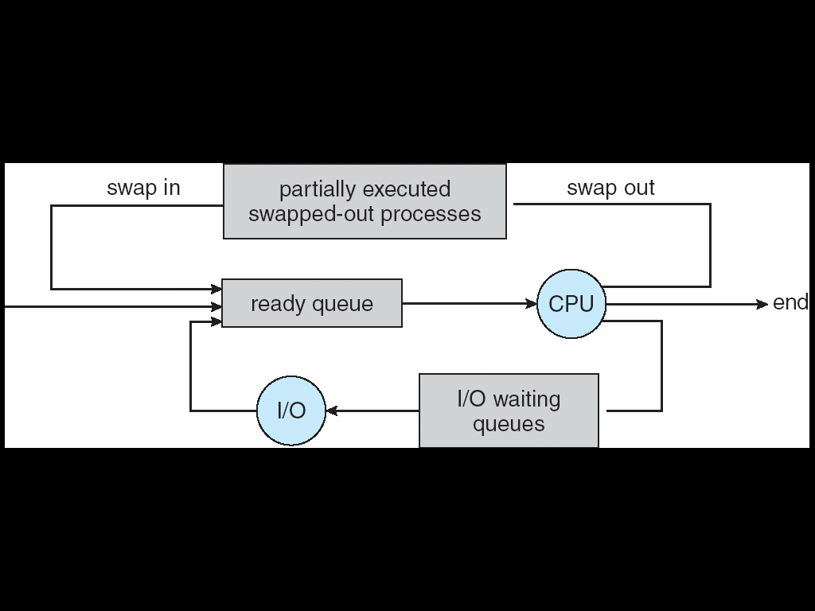
Fig 3.6 Addition of Medium Term Scheduling

Slide 30
Schedulers (Cont.)
Processes can be described as either:
I/O-bound process （I/O型进程）
spends more time doing I/O than computations, many short CPU bursts.
CPU-bound process （CPU 型进程）
spends more time doing computations; few I/O bursts.

Slide 31
3.2.3 Context Switch（上下文切换）
When CPU switches to another process, the system must save the state of the old process and load the saved state for the new process via a context switch
Context of a process represented in the PCB
Context-switch time is overhead; the system does no useful work while switching
Time dependent on hardware support

Slide 32
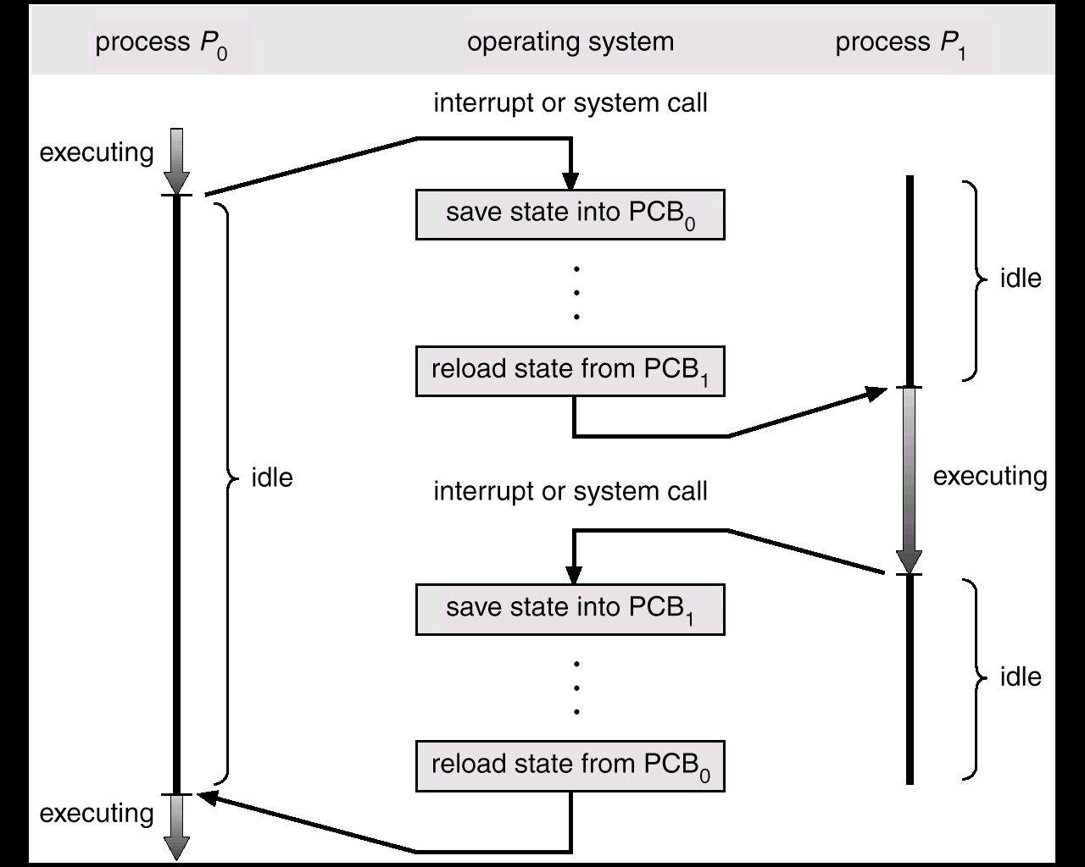
CPU Switch From Process to Process
A context switch occurs when the CPU
switches from one process to another.
context switch takes a few milliseconds

Slide 33
Multitasking in Mobile Systems
Due to screen real estate, user interface limits iOS provides for a
Single foreground process- controlled via user interface
Multiple background processes– in memory, running, but not on the display, and with limits
Limits include single, short task, receiving notification of events, specific long-running tasks like audio playback
Android runs foreground and background, with fewer limits
Background process uses a service to perform tasks
Service can keep running even if background process is suspended
Service has no user interface, small memory use
Notes:
屏幕面积

Slide 34
3.3 Operations on Processes

Slide 35
3.3 Operating on Processes 进程操作
3.3.1 Process Creation进程创建
Parent process create children processes, which, in turn create other processes, forming a tree of processes.
Generally, process identified and managed via a process identifier (pid)
Resource sharing：
Parent and children share all resources.
Children share subset of parent’s resources.
Parent and child share no resources.

Slide 36
Operating on Processes (Cont.)
Execution
Parent and children execute concurrently.
Parent waits until children terminate.
Address space 地址空间
Child duplicate of parent.
Child has a program loaded into it.

Slide 37
Process Creation (Cont.)
UNIX examples
fork system call creates new process
int pid1 = fork();
从系统调用 fork 中返回时，两个进程除了返回值 pid 1不同外，具有完全一样的用户级上下文。在子进程中，pid1 的值为0;父进程中， pid 1的值为子进程的进程号。
exec system call used after a fork to replace the process’ memory space with a new program.

Slide 38
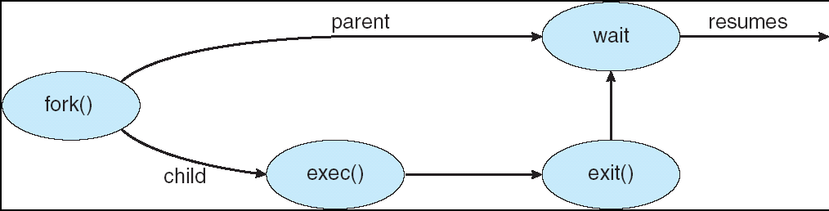
Process Creation

Slide 39
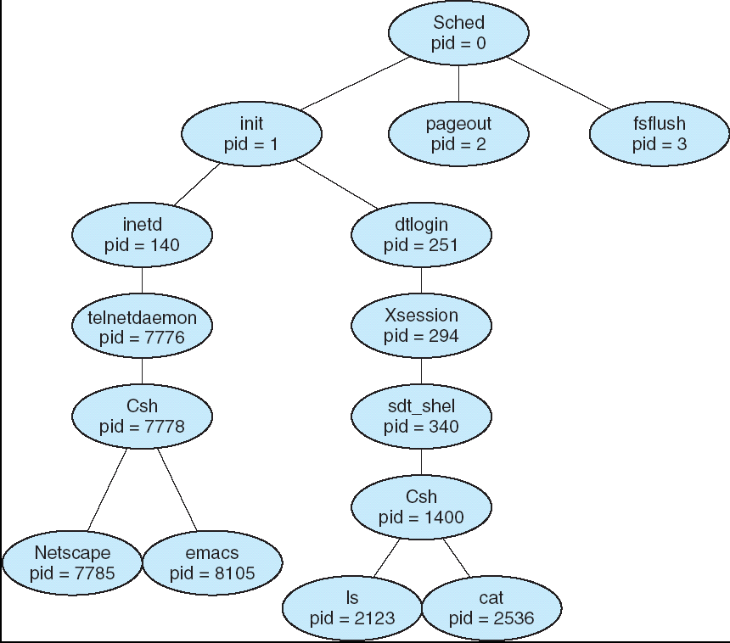
A tree of processes on a typical Solaris

Slide 40
C Program forking a separate process
＃include <stdio.h>
void main(int argc, char *argv[ ])
{ int pid1;
pid1=fork(); /* fork another process */
if (pid1<0){ fprintf(stderr, “Fork Failed”); exit(-1); }
else if (pid1==0) { execlp(“/bin/ls”,”ls”,NULL);
} /* child process */
else { wait(NULL);
printf(“child Complete”);
exit(0);
} /*parent process */
}
fork算法演示
WINDOWS example： CreateProcess.cpp

Slide 41
3.3.2 Process Termination 进程终止
引起进程终止的事件
正常结束
异常结束
外界干预
Process executes last statement and asks the operating system to decide it (exit).
Output data from child to parent (via wait).
Process’ resources are deallocated by operating system.

Slide 42

Process Termination (Cont.)
If a parent process is exiting, what happens to its child processes?
Some operating systems do not allow child processes to continue running
Child processes may be terminated via cascading termination
Child processes may be inherited by a different parent process

Slide 43
Android Process Importance Hierarchy
Mobile operating systems often have to terminate processes to reclaim system resources such as memory. From most to least important:
Foreground process
Visible process
Service process
Background process
Empty process
Android will begin terminating processes that are least important.

Slide 44
3.4 Interprocess Communication

Slide 45
Interprocess Communication 进程通信
Independent process cannot affect or be affected by the execution of another process.
Cooperating process can affect or be affected by the execution of another process
Advantages of process cooperation
Information sharing
Computation speed-up
Modularity
Convenience
Cooperating processes need interprocess communication (IPC)

Slide 46
Interprocess Communication (IPC) 进程间通信
IPC provides a Mechanism for processes to communicate and to synchronize their actions without sharing the same address space .
process Q
communication channel
process P

Slide 47
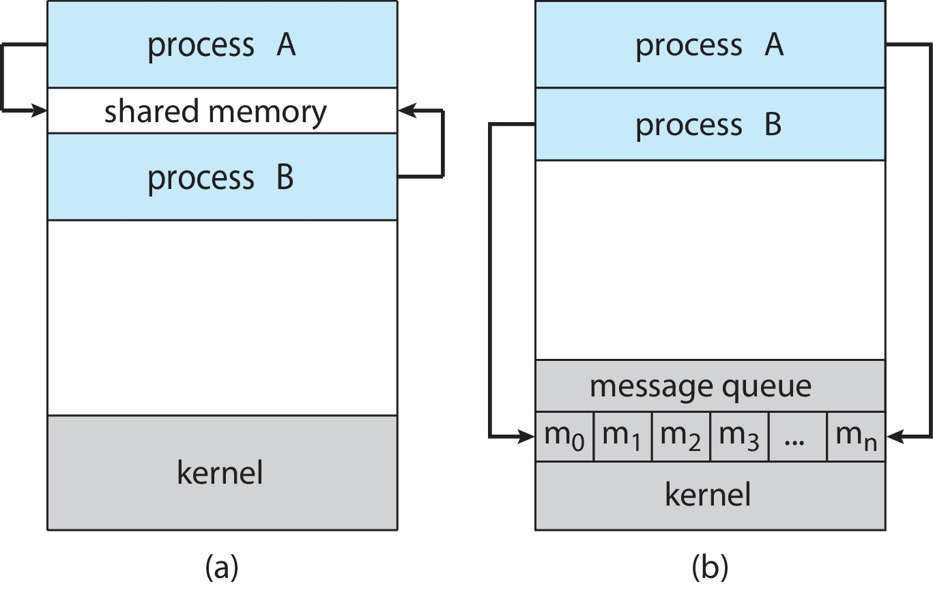
Communications Models
Two models of IPC
Shared memory
Message passing
(a) Shared memory. (b) Message passing.

Slide 48
IPC
通信类型：
直接通信
send (P, message) – 直接发消息给进程P
receive(Q, message) – 直接接收来自进程Q的消息
间接通信
send(A, message) – 发送消息给邮件服务器A
receive(A, message) – 从邮件服务器A接收消息
常用通信机制：
信号(signal)
共享存储区(shared memory)
管道(pipe)
消息(message)
套接字(socket)

Slide 49
Linux进程通信机制
Linux实现进程间通信(IPC Inter Process Communication)：
System V IPC机制:
信号量、 消息队列、 共享内存
管道（pipe）、命名管道
套接字（socket）
信号( signal )
文件锁(file lock)
POSIX线程：
互斥锁(互斥体、互斥量)（mutex）、条件变量(condition variables)
POSIX：
消息队列、信号、共享内存

Slide 50
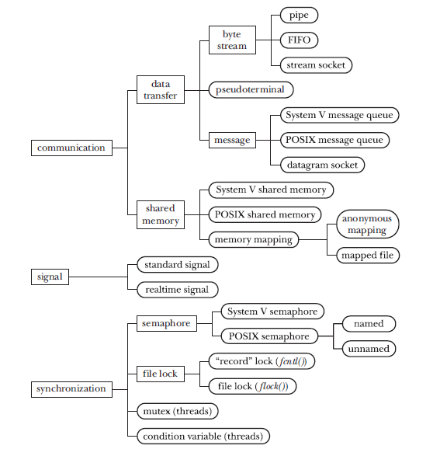
UNIX IPC 工具分类

Slide 51
Windows 进程线程通信机制
基于文件映射的共享存储区
无名管道和命名管道
server32pipe.c、client32pipe.c
启动多个client进程进行通信
邮件槽
套接字
剪帖板(Clipboard)
信号
其他同步机制
Windows Interprocess Communication

Slide 52
3.5 IPC in Shared-Memory Systems

Slide 53
Interprocess Communication – Shared Memory
An area of memory shared among the processes that wish to communicate
The communication is under the control of the users processes not the operating system.
Major issues is to provide mechanism that will allow the user processes to synchronize their actions when they access shared memory.
Synchronization is discussed in great details in Chapters 6 & 7.

Slide 54
Shared-Memory Solution
Concurrent execution of cooperating processes requires mechanisms that allow processes to communicate with one another and synchronize their actions (chap 6).
Common Paradigm for cooperating processes -- Producer-Consumer Problem （生产者-消费者问题）
A producer process produces information that is consumed by a consumer process.
unbounded-buffer（无限缓冲区） places no practical limit on the size of the buffer.
bounded-buffer（有限缓冲区） assumes that there is a fixed buffer size.

Slide 55
Bounded-Buffer – Shared-Memory Solution
Shared-Memory Solution to the Bounded-Buffer problem : Shared data
#define BUFFER_SIZE 10
typedef struct {
. . .
} item;
item buffer[BUFFER_SIZE];
int in = 0;
int out = 0;
Solution is correct, but can only use BUFFER_SIZE-1 elements

Slide 56
Bounded-Buffer – Producer Process
Producer :
item nextProduced; while (1) {
produce an item in nextProduced ;
while (((in + 1) % BUFFER_SIZE) == out)
; /* do nothing */
buffer[in] = nextProduced;
in = (in + 1) % BUFFER_SIZE;
}

Slide 57
Bounded-Buffer – Consumer Process
Consumer :
item nextConsumed;
while (1) {
while (in == out)
; /* do nothing */
nextConsumed = buffer[out];
out = (out + 1) % BUFFER_SIZE;
consume the item in nextConsumed ;
}

Slide 58
3.6 IPC in Message-Passing Systems

Slide 59
Interprocess Communication – Message Passing
Mechanism for processes to communicate and to synchronize their actions
Message system – processes communicate with each other without resorting to shared variables
IPC facility provides two operations:
send(message)
receive(message)
The message size is either fixed or variable

Slide 60
Message Passing (Cont.)
If processes P and Q wish to communicate, they need to:
Establish a communication link between them
Exchange messages via send/receive
Implementation issues:
How are links established?
Can a link be associated with more than two processes?
How many links can there be between every pair of communicating processes?
What is the capacity of a link?
Is the size of a message that the link can accommodate fixed or variable?
Is a link unidirectional or bi-directional?

Slide 61
Message Passing (Cont.)
Implementation of communication link
Physical:
Shared memory
Hardware bus
Network
Logical:
Direct or indirect
Synchronous or asynchronous
Automatic or explicit buffering

Slide 62
Direct Communication（直接通信）
Processes must name each other explicitly:
send (P, message) – send a message to process P
receive(Q, message) – receive a message from process Q
Properties of communication link
Links are established automatically
A link is associated with exactly one pair of communicating processes
Between each pair there exists exactly one link
The link may be unidirectional, but is usually bi-directional

Slide 63
Indirect Communication（间接通信）
Messages are directed and received from mailboxes (also referred to as ports)
Each mailbox has a unique id
Processes can communicate only if they share a mailbox
Properties of communication link
Link established only if processes share a common mailbox
A link may be associated with many processes
Each pair of processes may share several communication links
Link may be unidirectional or bi-directional

Slide 64
Indirect Communication
Operations
create a new mailbox (port)
send and receive messages through mailbox
destroy a mailbox
Primitives are defined as:
send(A, message) – send a message to mailbox A
receive(A, message) – receive a message from mailbox A

Slide 65
Indirect Communication
Mailbox sharing
P₁, P₂, and P₃ share mailbox A
P₁, sends; P₂ and P₃ receive
Who gets the message?
Solutions
Allow a link to be associated with at most two processes
Allow only one process at a time to execute a receive operation
Allow the system to select arbitrarily the receiver. Sender is notified who the receiver was.

Slide 66
Synchronization
Message passing may be either blocking or non-blocking
Blocking（阻塞） is considered synchronous
Blocking send -- the sender is blocked until the message is received
Blocking receive -- the receiver is blocked until a message is available
Non-blocking （非阻塞） is considered asynchronous
Non-blocking send -- the sender sends the message and continue
Non-blocking receive -- the receiver receives:
A valid message, or
Null message
Different combinations possible
If both send and receive are blocking, we have a rendezvous

Slide 67
Producer – Message Passing
message next_produced;
while (true) { /* produce an item in next_produced */
send(next_produced);
}

Slide 68
Consumer– Message Passing
message next_consumed;
while (true) { receive(next_consumed) /* consume the item in next_consumed */ }

Slide 69
Buffering
Queue of messages attached to the link.
Implemented in one of three ways
1. Zero capacity – no messages are queued on a link. Sender must wait for receiver (rendezvous)
2. Bounded capacity – finite length of n messages Sender must wait if link full
3. Unbounded capacity – infinite length Sender never waits

Slide 70
实例
例： 设计一个程序，要求用函数msgget创建消息队列，从键盘输入的字符串添加到消息队列。创建一个进程，使用函数msgrcv读取队列中的消息并在计算机屏幕上输出。
分析 ：程序先调用msgget函数创建、打开消息队列，接着调用msgsnd函数，把输入的字符串添加到消息队列中。子进程调用msgrcv函数，读取消息队列中的消息并打印输出，最后调用msgctl函数，删除系统内核中的消息队列。

Slide 71
实例
//msgfork.c
#include <stdio.h>
#include <string.h>
#include <stdlib.h>
#include <sys/types.h>
#include <sys/msg.h>
#include <sys/ipc.h>
#include <unistd.h>
struct msgmbuf { /*结构体，定义消息的结构*
long msg_type; /*消息类型*/
char msg_text[512]; }; /*消息内容*/
int main(){
int qid,len;
key_t key;
struct msgmbuf msg;
Notes:
~/Linuxp/7-10.c

Slide 72
实例
if((key=ftok(".",'a'))==-1) { /*调用ftok函数，产生标准的key*/
perror("产生标准key出错");
exit(1);}
/*调用msgget函数，创建、打开消息队列*/
if((qid=msgget(key,IPC_CREAT|0666))==-1) {
perror("创建消息队列出错");
exit(1);}
printf("创建、打开的队列号是：%d\n",qid); /*打印输出队列号*/

Slide 73
实例
int pid=fork();
if (pid>0){
printf(" 我是父进程PID=：%d 发送消息\n",getpid())
puts("请输入要加入队列的消息：");
/*键盘输入的消息存入变量msg_text*/
if((fgets((&msg)->msg_text,512,stdin))==NULL) {
puts("没有消息");
exit(1);}
msg.msg_type=getpid();
len=strlen(msg.msg_text);
/*调用msgsnd函数，添加消息到消息队列*/
if((msgsnd(qid,&msg,len,0))<0) {
perror("添加消息出错");
exit(1);}
}

Slide 74
实例
else{
printf("我是子进程PID=：%d 接收消息\n",getpid())
/*调用msgrcv函数，从消息队列读取消息*/
if((msgrcv(qid,&msg,512,0,0))<0) {
perror("读取消息出错");
exit(1);}
/*打印输出消息内容*/
printf("读取的消息是：%s\n",(&msg)->msg_text);
/*调用msgctl函数，删除系统中的消息队列*/
if((msgctl(qid,IPC_RMID,NULL))<0){
perror("删除消息队列出错");
exit(1);}
}
exit (0);}

Slide 75
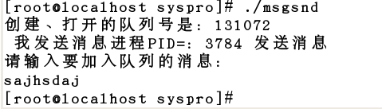
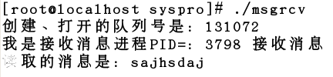
实例
分成两个独立的程序：msgsnd.c,msgrcv.c。分别编译和运行

Slide 76
3.7 Examples of IPC Systems

Slide 77
Examples of IPC Systems - POSIX
POSIX Shared Memory
Process first creates shared memory segment shm_fd = shm_open(name, O CREAT | O RDWR, 0666);
Also used to open an existing segment
Set the size of the object
ftruncate(shm_fd, 4096);
Use mmap() to memory-map a file pointer to the shared memory object
Reading and writing to shared memory is done by using the pointer returned by mmap().

Slide 78
IPC POSIX Producer
/* shared memory file descriptor */
int fd;
/* pointer to shared memory obect */
char *ptr;
/* create the shared memory object */
fd = shm open(name,O CREAT | O RDWR,0666);
/* configure the size of the shared memory object */
ftruncate(fd, SIZE);
/* memory map the shared memory object */
ptr = (char *)mmap(0, SIZE, PROT READ | PROT WRITE, MAP SHARED, fd, 0);
/* write to the shared memory object */
sprintf(ptr,"%s",message 0);
ptr += strlen(message 0);
sprintf(ptr,"%s",message 1);
ptr += strlen(message 1);
return 0;
}
#include <stdio.h>
#include <stdlib.h>
#include <string.h>
#include <fcntl.h>
#include <sys/shm.h>
#include <sys/stat.h>
#include <sys/mman.h>
int main()
{
/* the size (in bytes) of shared memory
object */
const int SIZE = 4096;
/* name of the shared memory object */
const char *name = "OS";
/* strings written to shared memory */
const char *message 0 = "Hello";
const char *message 1 = "World!";

Slide 79
IPC POSIX Consumer
#include <stdio.h>
#include <stdlib.h>
#include <fcntl.h>
#include <sys/shm.h>
#include <sys/stat.h>
#include <sys/mman.h>
int main()
{
/* the size (in bytes) of shared memory object */
const int SIZE = 4096;
/* name of the shared memory object */
const char *name = "OS";
/* shared memory file descriptor */
int fd;
/* pointer to shared memory obect */
char *ptr;
/* open the shared memory object */
fd = shm open(name, O RDONLY, 0666);
/* memory map the shared memory object */
ptr = (char *)
mmap(0, SIZE, PROT READ | PROT WRITE, MAP SHARED, fd, 0);
/* read from the shared memory object */
printf("%s",(char *)ptr);
/* remove the shared memory object */
shm unlink(name);
return 0;
}

Slide 80
Examples of IPC Systems – Windows
Message-passing centric via advanced local procedure call (LPC) facility
Only works between processes on the same system
Uses ports (like mailboxes) to establish and maintain communication channels
Communication works as follows:
The client opens a handle to the subsystem’s connection port object.
The client sends a connection request.
The server creates two private communication ports and returns the handle to one of them to the client.
The client and server use the corresponding port handle to send messages or callbacks and to listen for replies.

Slide 81
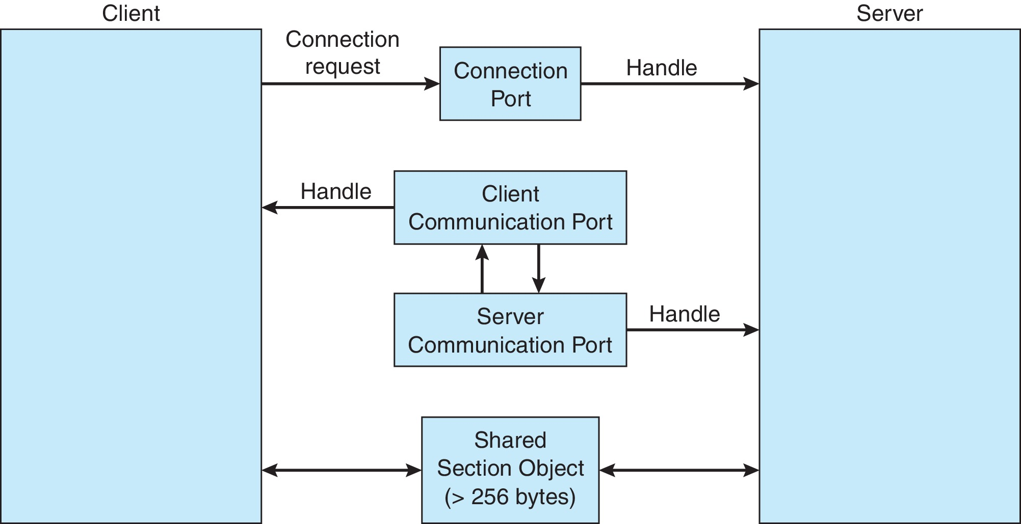
Local Procedure Calls in Windows

Slide 82
Pipes
Acts as a conduit allowing two processes to communicate
Issues:
Is communication unidirectional or bidirectional?
In the case of two-way communication, is it half or full-duplex?（在工作时是否只有一端读或写？）
Must there exist a relationship (i.e., parent-child) between the communicating processes?
Can the pipes be used over a network?
Ordinary pipes – cannot be accessed from outside the process that created it. Typically, a parent process creates a pipe and uses it to communicate with a child process that it created.
Named pipes – can be accessed without a parent-child relationship.

Slide 83
Ordinary Pipes
Ordinary Pipes allow communication in standard producer-consumer style
Producer writes to one end (the write-end of the pipe)
Consumer reads from the other end (the read-end of the pipe)
Ordinary pipes are therefore unidirectional
Require parent-child relationship between communicating processes
Windows calls these anonymous pipes

Slide 84
Named Pipes
Named Pipes are more powerful than ordinary pipes
Communication is bidirectional
No parent-child relationship is necessary between the communicating processes
Several processes can use the named pipe for communication
Provided on both UNIX and Windows systems

Slide 85
3.8 Communication in Client–Server Systems

Slide 86
Communications in Client-Server Systems
Sockets
Remote Procedure Calls

Slide 87
Sockets
A socket is defined as an endpoint for communication
Concatenation of IP address and port – a number included at start of message packet to differentiate network services on a host
The socket 161.25.19.8:1625 refers to port 1625 on host 161.25.19.8
Communication consists between a pair of sockets
All ports below 1024 are well known, used for standard services
Special IP address 127.0.0.1 (loopback) to refer to system on which process is running

Slide 88
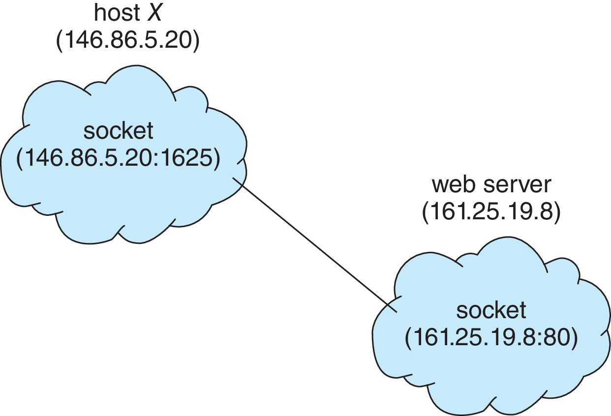
Socket Communication

Slide 89
Sockets in Java
Three types of sockets
Connection-oriented (TCP)
Connectionless (UDP)
MulticastSocket class– data can be sent to multiple recipients
Consider this “Date” server in Java:

Slide 90
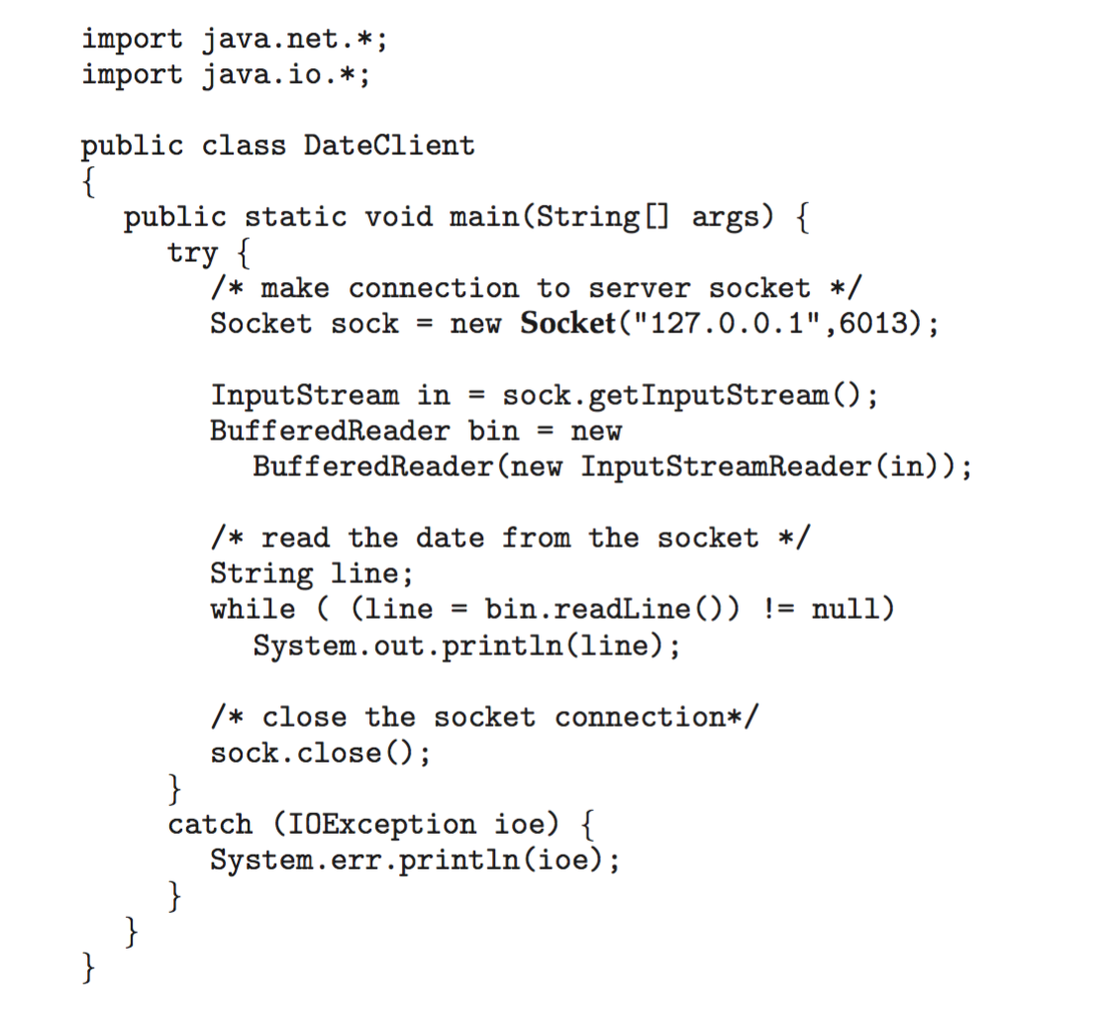
Sockets in Java
The equivalent Date client

Slide 91
Remote Procedure Calls（远过程调用）
Remote procedure call (RPC) abstracts procedure calls between processes on networked systems
Again uses ports for service differentiation
Stubs – client-side proxy for the actual procedure on the server
The client-side stub locates the server and marshalls the parameters
The server-side stub receives this message, unpacks the marshalled parameters, and performs the procedure on the server
On Windows, stub code compile from specification written in Microsoft Interface Definition Language (MIDL)

Slide 92
Remote Procedure Calls (Cont.)
Data representation handled via External Data Representation (XDL) format to account for different architectures
Big-endian and little-endian
Remote communication has more failure scenarios than local
Messages can be delivered exactly once rather than at most once
OS typically provides a rendezvous (or matchmaker) service to connect client and server

Slide 93
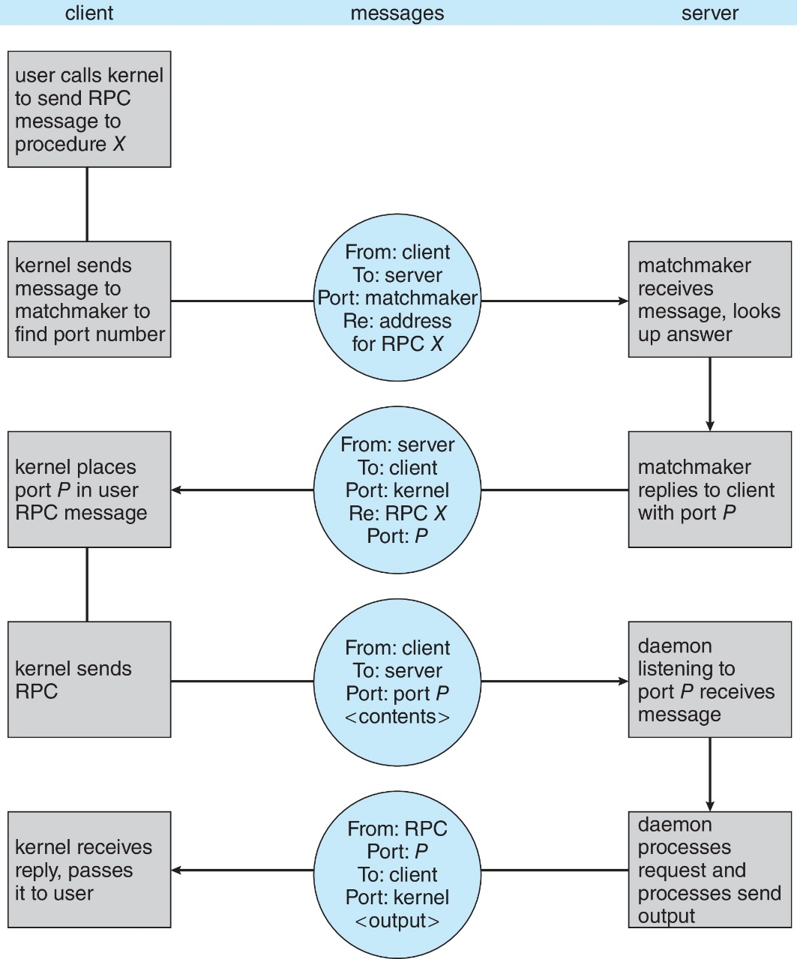
Execution of Android RPC

Slide 94
Homework
书后习题3.2
10月30日晚上12点前上交
通过“学在浙大”提交作业
上传文件时，"名字"填"作业1"、"作业2" 等，"姓氏"请填"个人姓名“
文件名以“学号-姓名-作业x”命名，例如“3170100000-张三-作业1”
有问题可询问TA 曾奕久 18888921519 22221190@zju.edu.cn

Slide 95
End of Chapter 3
Notes:
95

